Slide 1
Justify!
Acquired Plant Traits
2023 Baylor College of Medicine. Field Test Version: Do not distribute, photocopy, or forward this document for use at other locations.

Slide 2
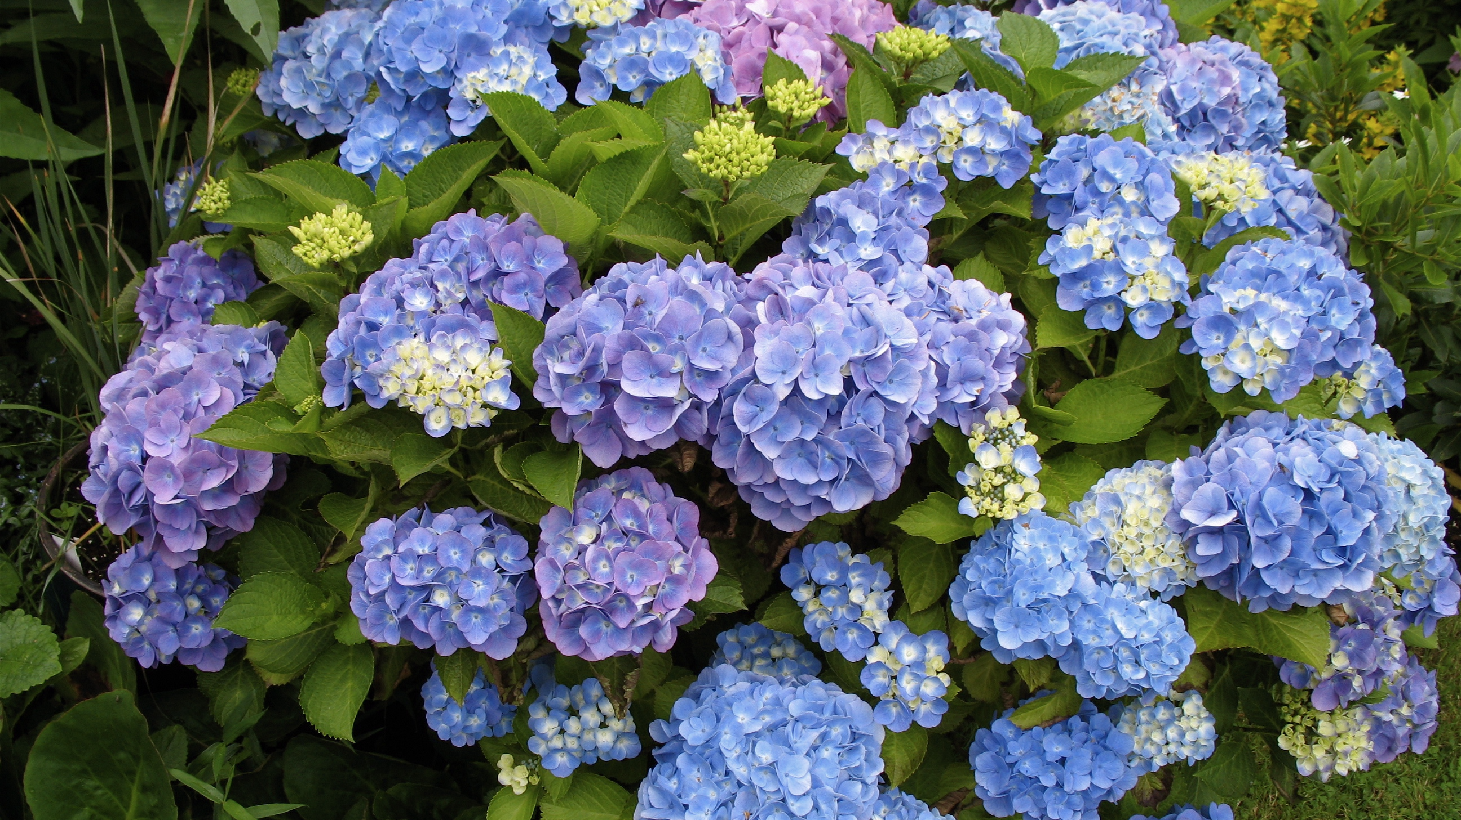

Slide 3
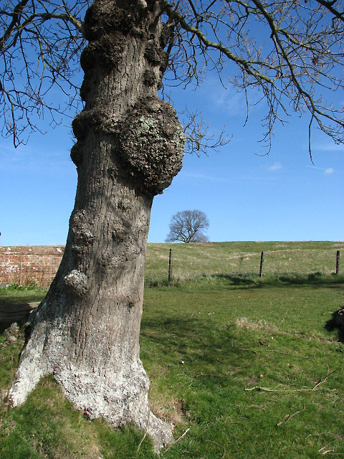

Slide 4
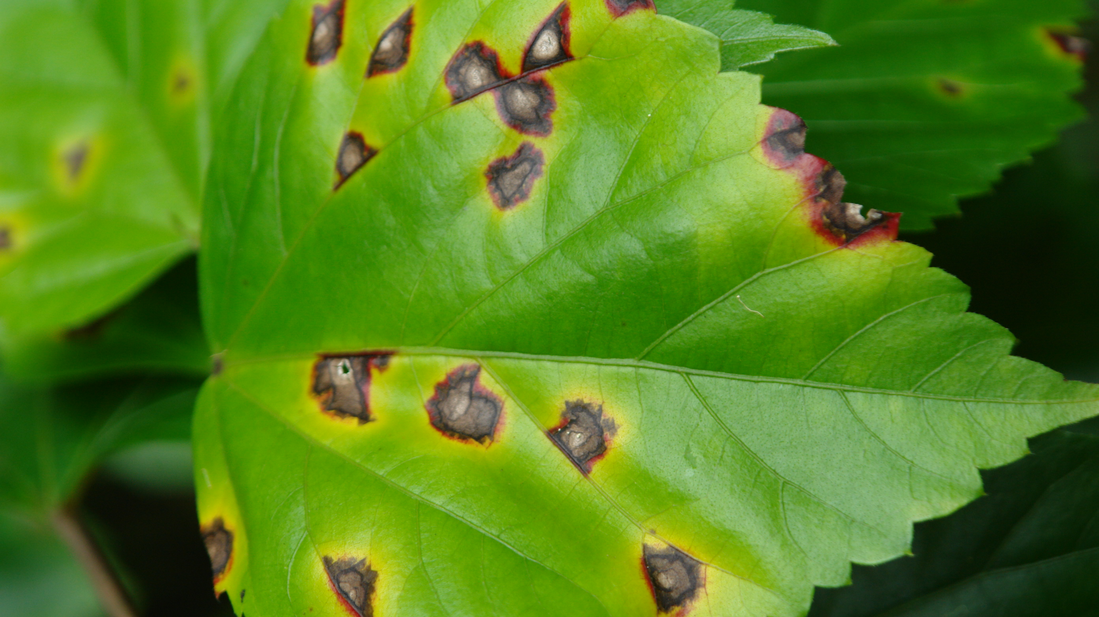

Slide 5
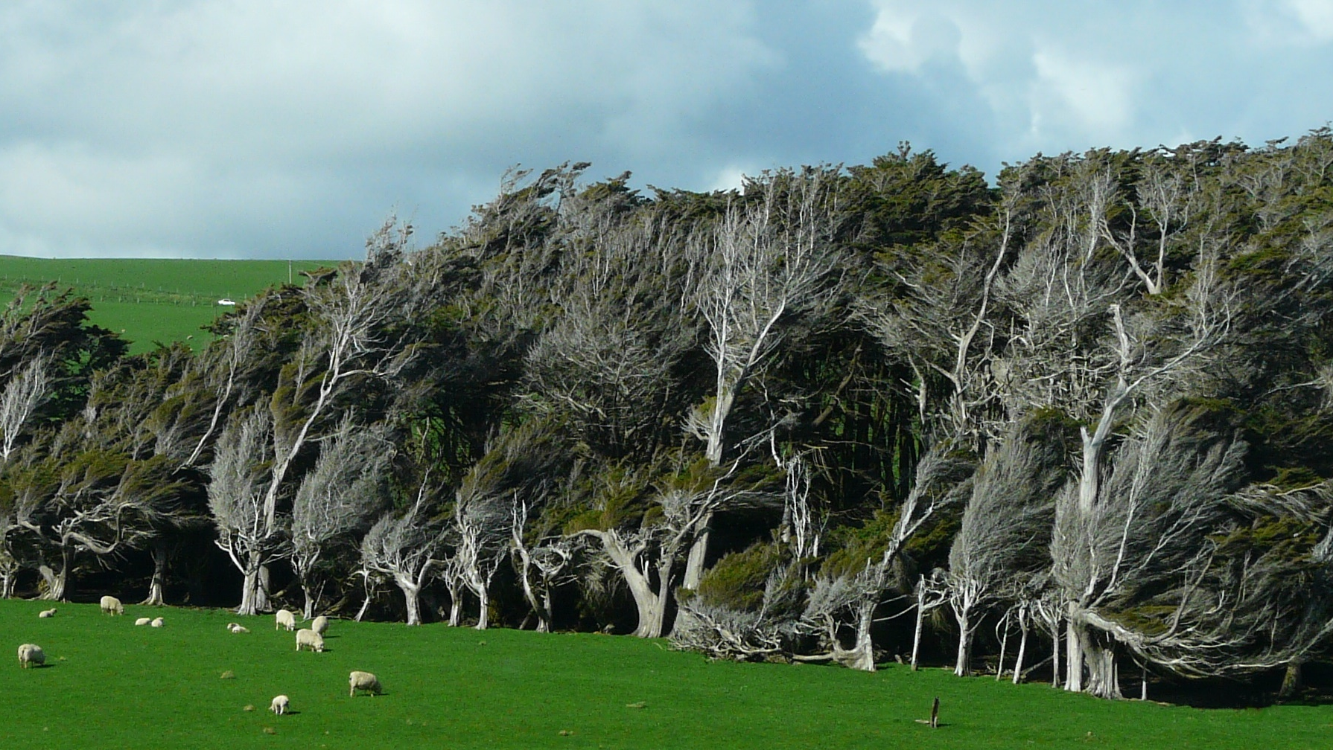

Slide 6
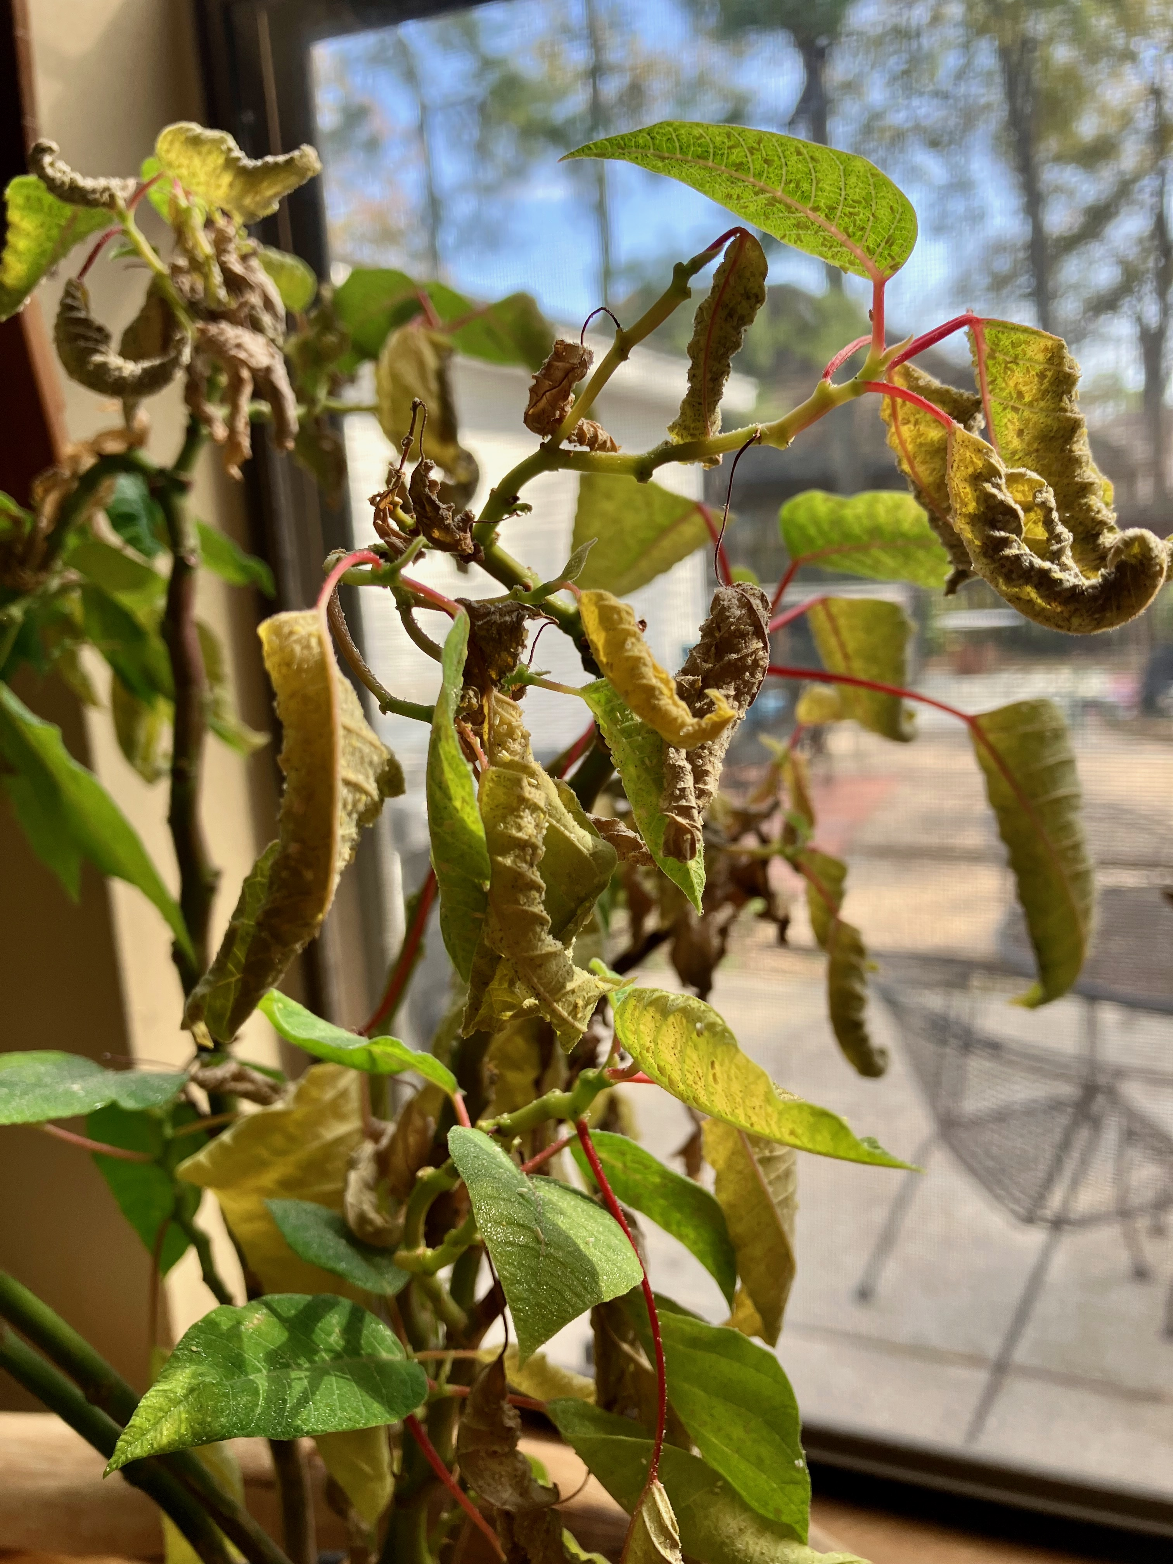

Slide 7


Slide 8
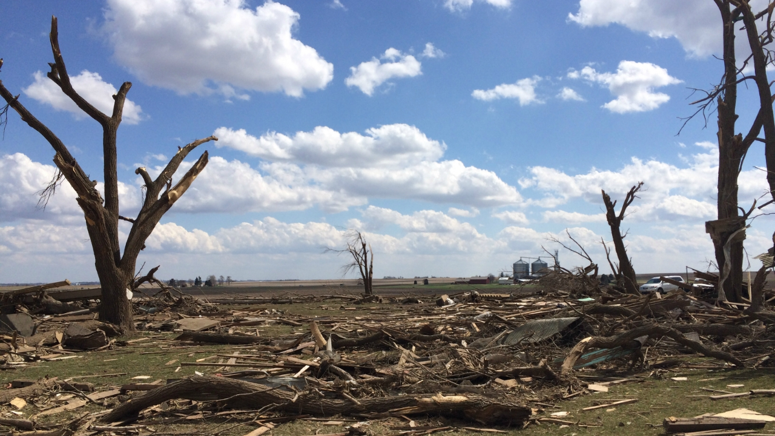

Slide 9
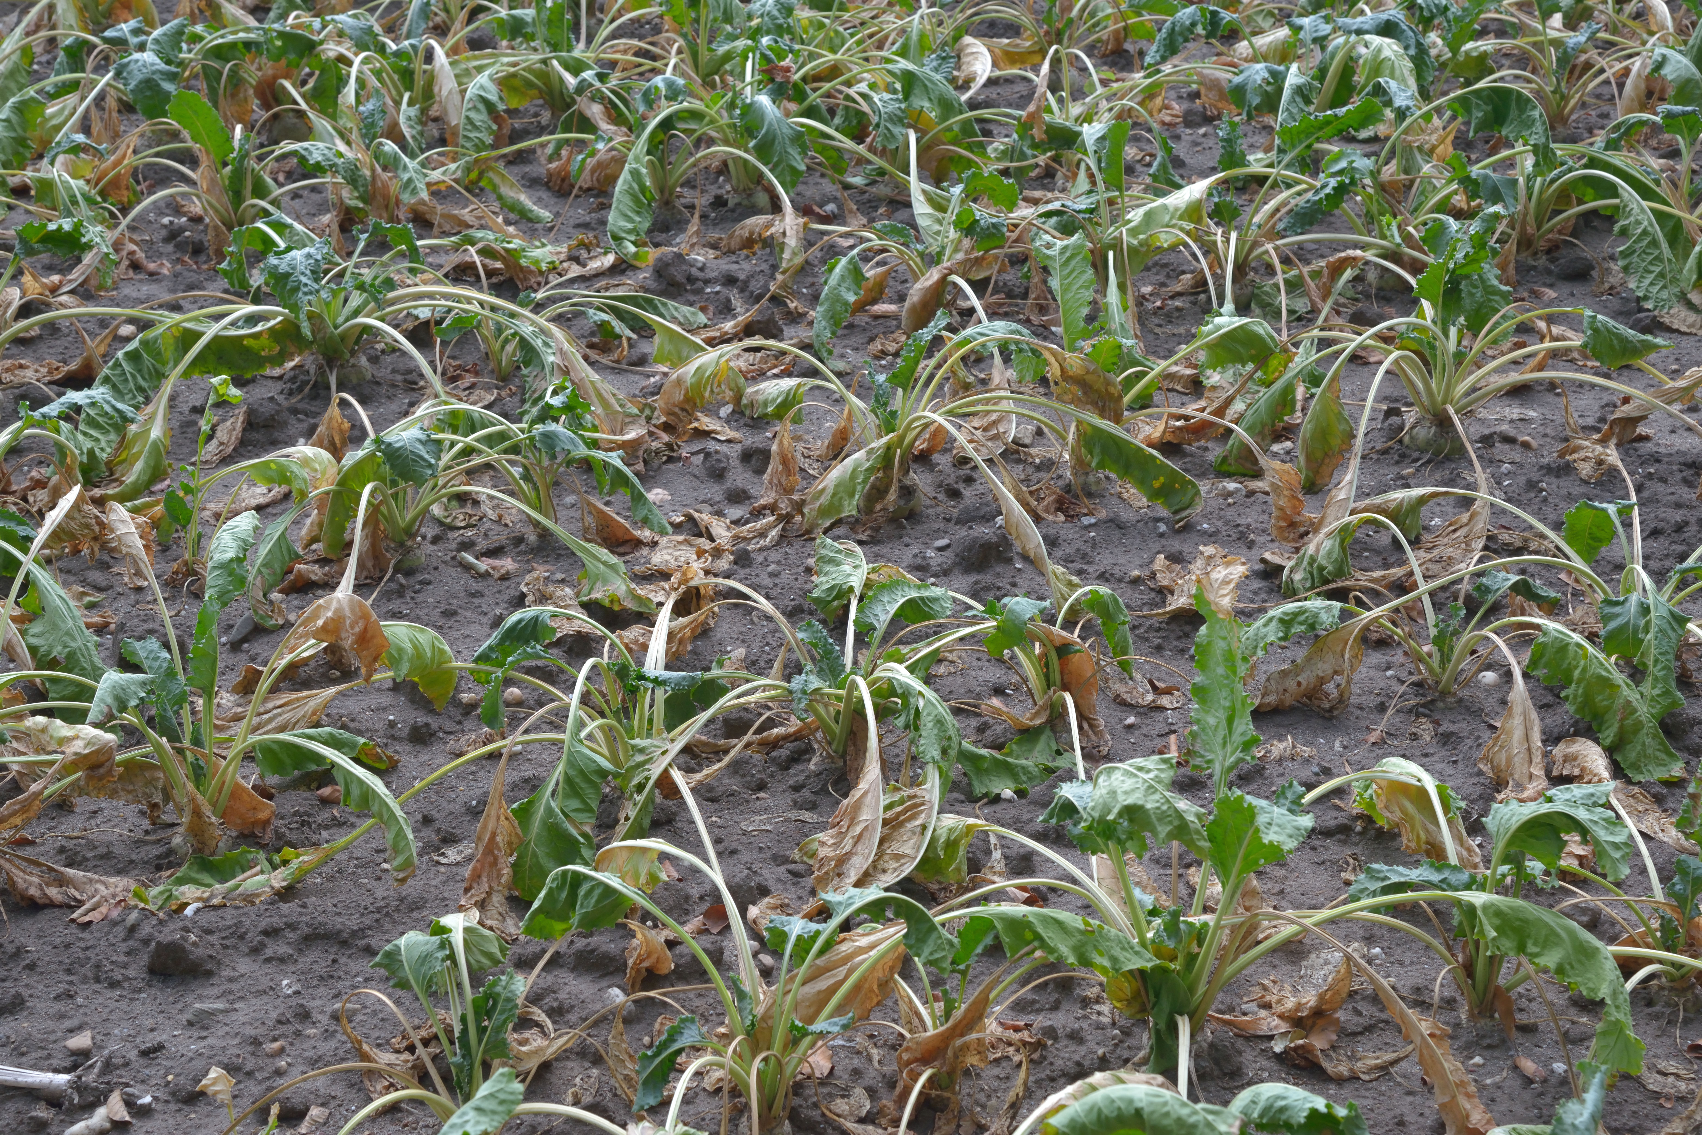

Slide 10
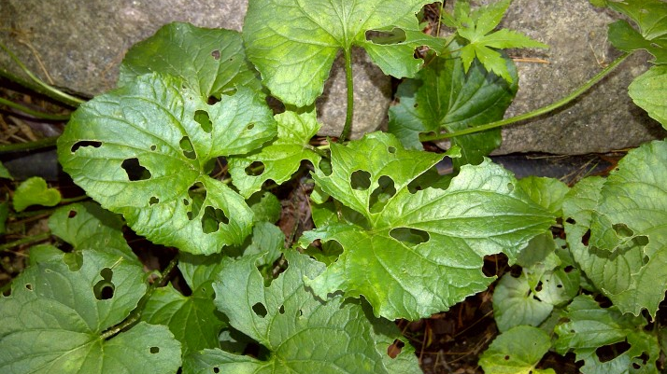
Notes:
This Photo by Unknown Author is licensed under CC BY-ND

