Slide 1


Science Language Picture Cards
for
Plant Traits:
Inherited and Acquired (G4)

Slide 2
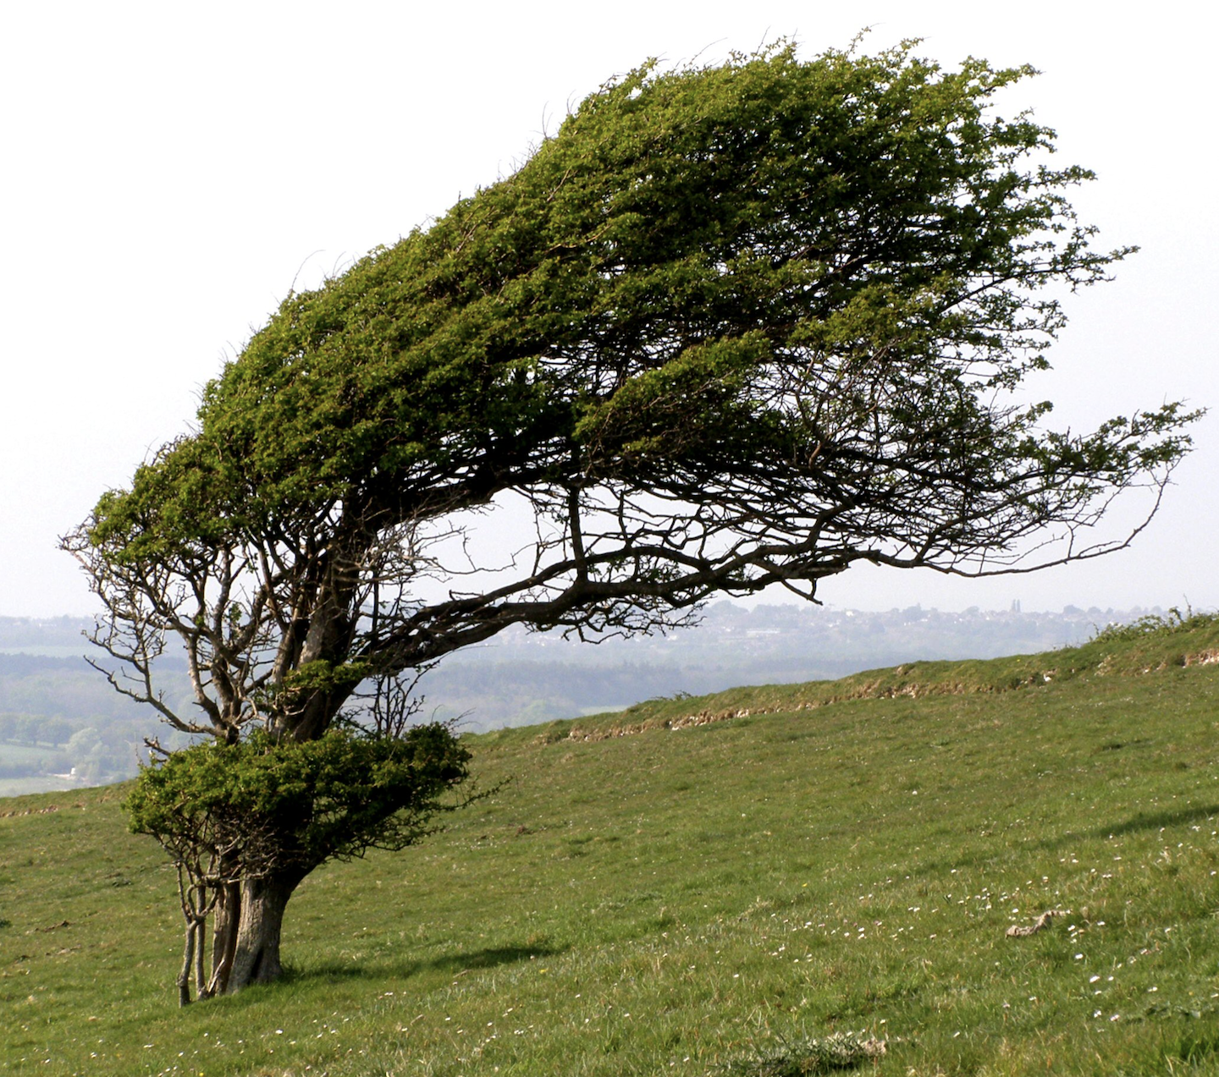
Acquired Traits
Acquired traits are not passed down but are the result of environmental or external factors.
​
"Windswept Tree" by Auntie P is licensed under CC BY-NC-SA 2.0.

Slide 3
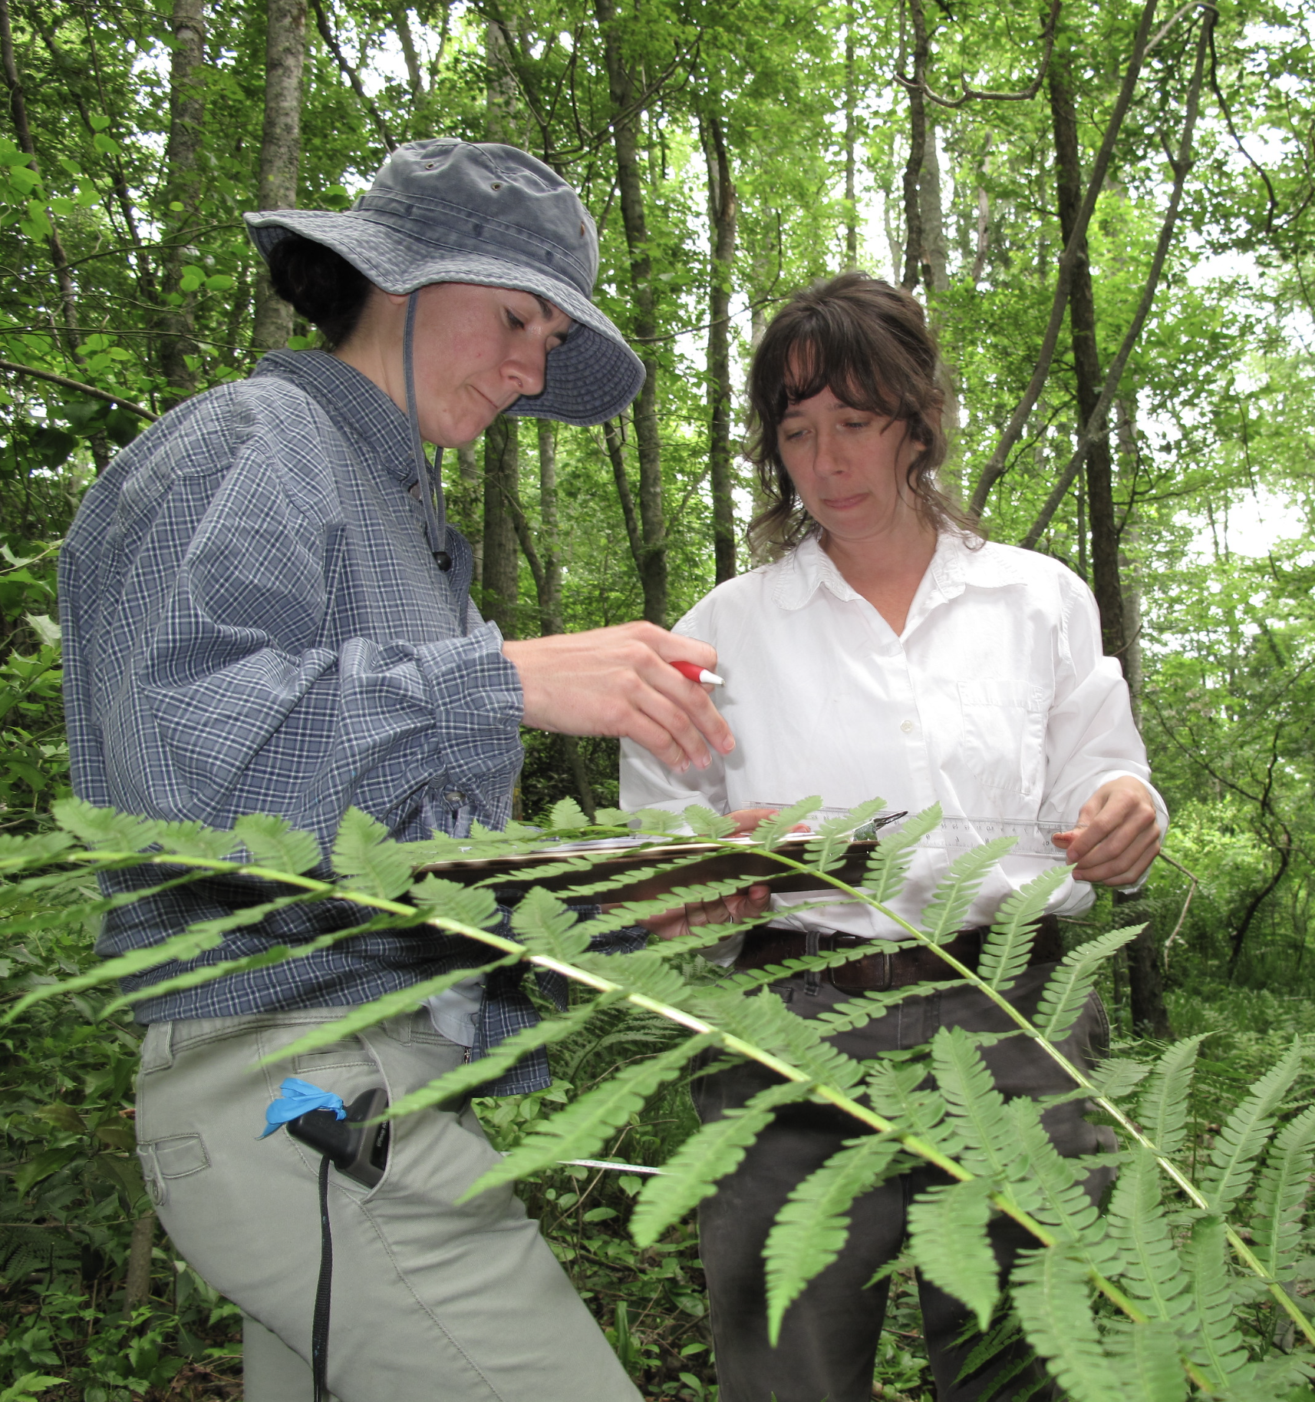
Botanist
A botanist is an expert in the scientific study of plants.
"2010 May - The Nature Conservancy's Megan Gibney and Service botanist Carolyn Wells recording data" by USFWS/Southeast is licensed under CC BY 2.0.

Slide 4

Claim
A claim is a statement of
what you think is true based
on observation and evidence.
"2010-07-11 - Summer Camp 2010 - Kids talking notes in the woods" by Leslie Science & Nature Center
is licensed under CC BY-SA 2.0.​

Slide 5
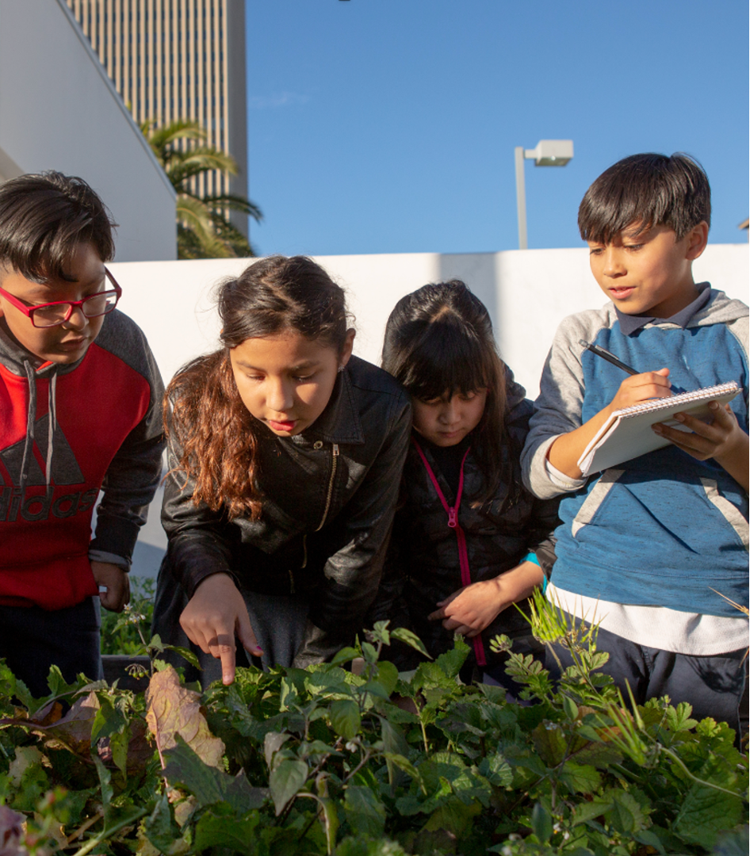
Collaboration
Collaboration occurs when two or more people work together, learn from each other, and communicate ​
with each other.​
Photo by Allison Shelly for EDUimages, CC BY-NC 4.0

Slide 6
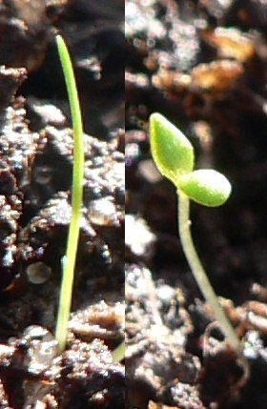
Cotyledon
The cotyledon is the seed leaf within the embryo and a source of stored food for the seedling.
Plants that have one cotyledon or seed leaf are called monocots; plants with two seed leaves are called dicots.
User:Pengo, CC BY-SA 2.5 <https://creativecommons.org/licenses/by-sa/2.5>, via Wikimedia Commons

Slide 7
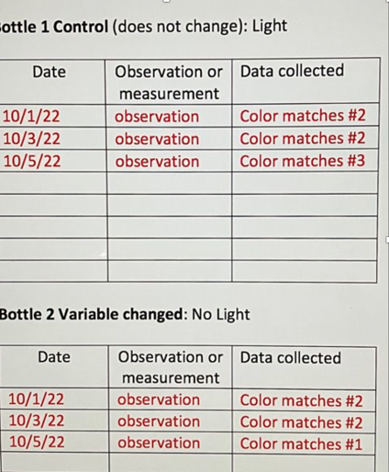
Data
Data are facts and
information (such as images, words, and measurements, collected during an an investigation.

Slide 8
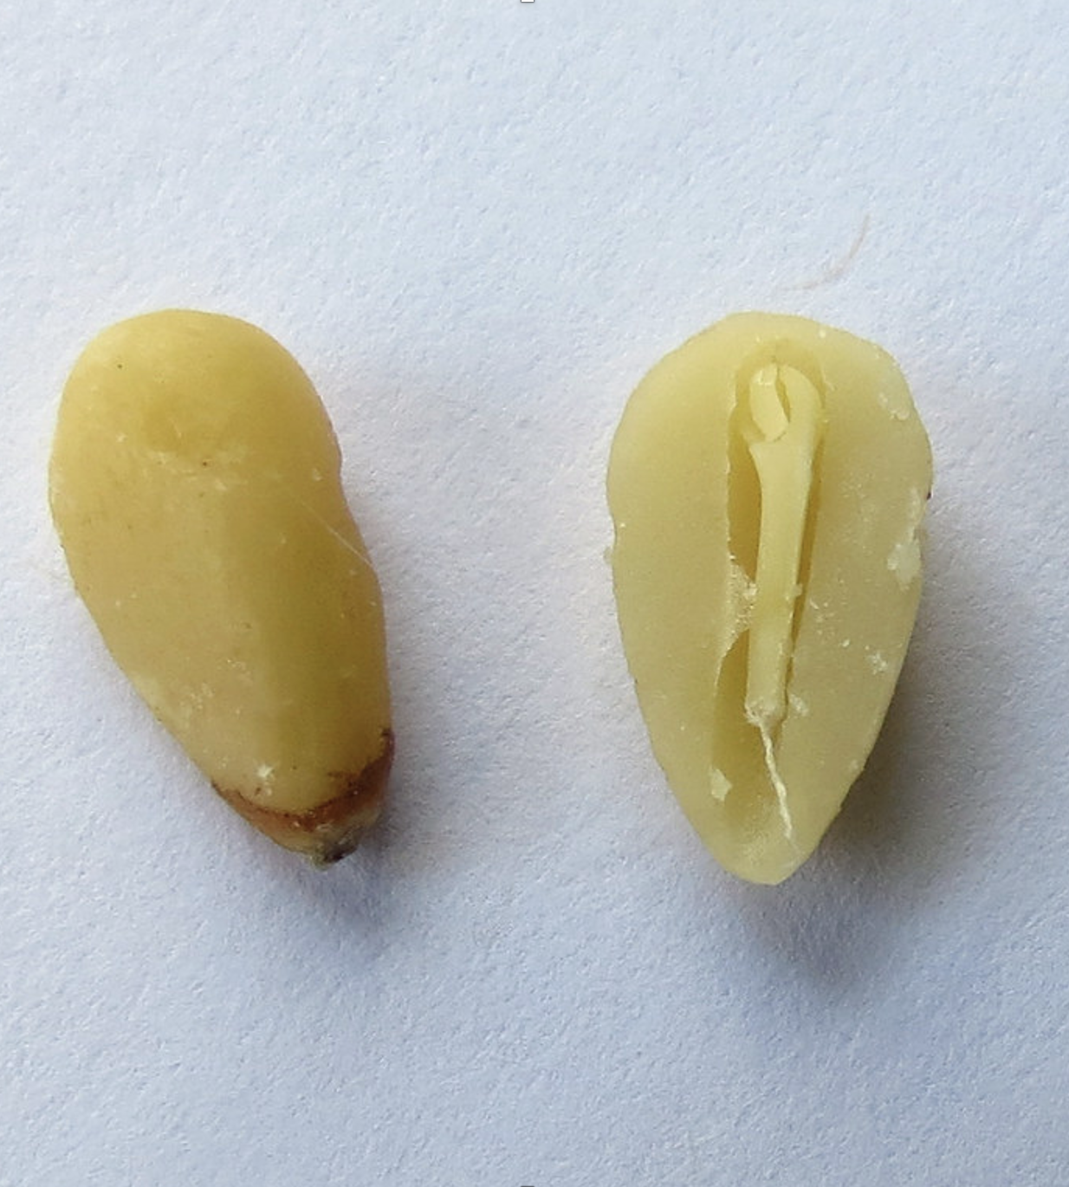
Embryo
The embryo is the tiny plant inside the seed.

Slide 9
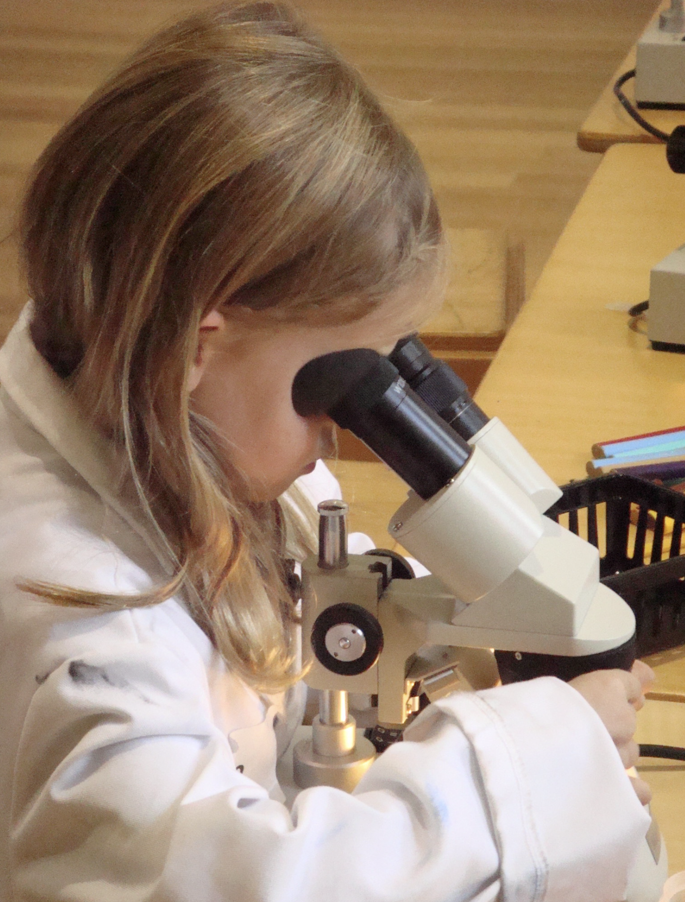
Evidence
Evidence is data collected from the investigation that supports (backs up) explanations and answers.
"Cleo looking through the stereo microscope with rolled up lab coat sleeves" by scalefreenetwork is licensed under CC BY-NC-SA 2.0. To view a copy of this license, visit https://creativecommons.org/licenses/by-nc-sa/2.0/?ref=openverse.

Slide 10
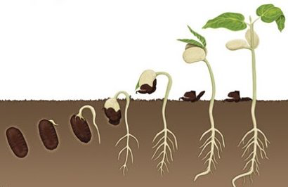
Germination
Germination is the process by which a plant grows from a seed.
This Photo by Unknown author is licensed under CC BY.​

Slide 11
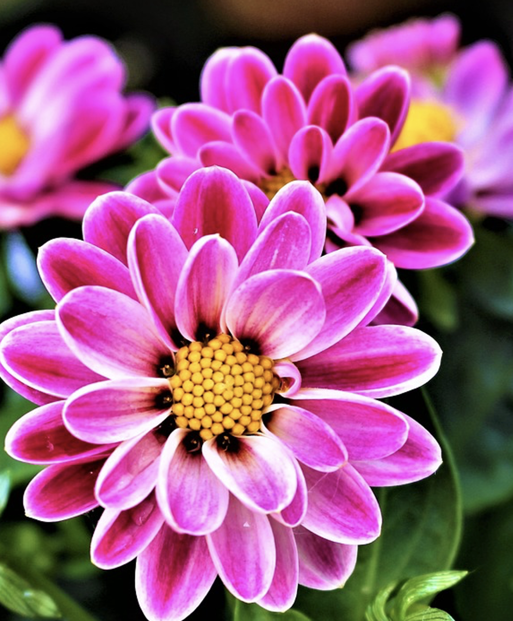
Inherited Traits
Inherited traits are passed down from parent to offspring.
Free photo: Flowers, Petal, Flowering, Plants - Free Image on Pixabay ...

Slide 12
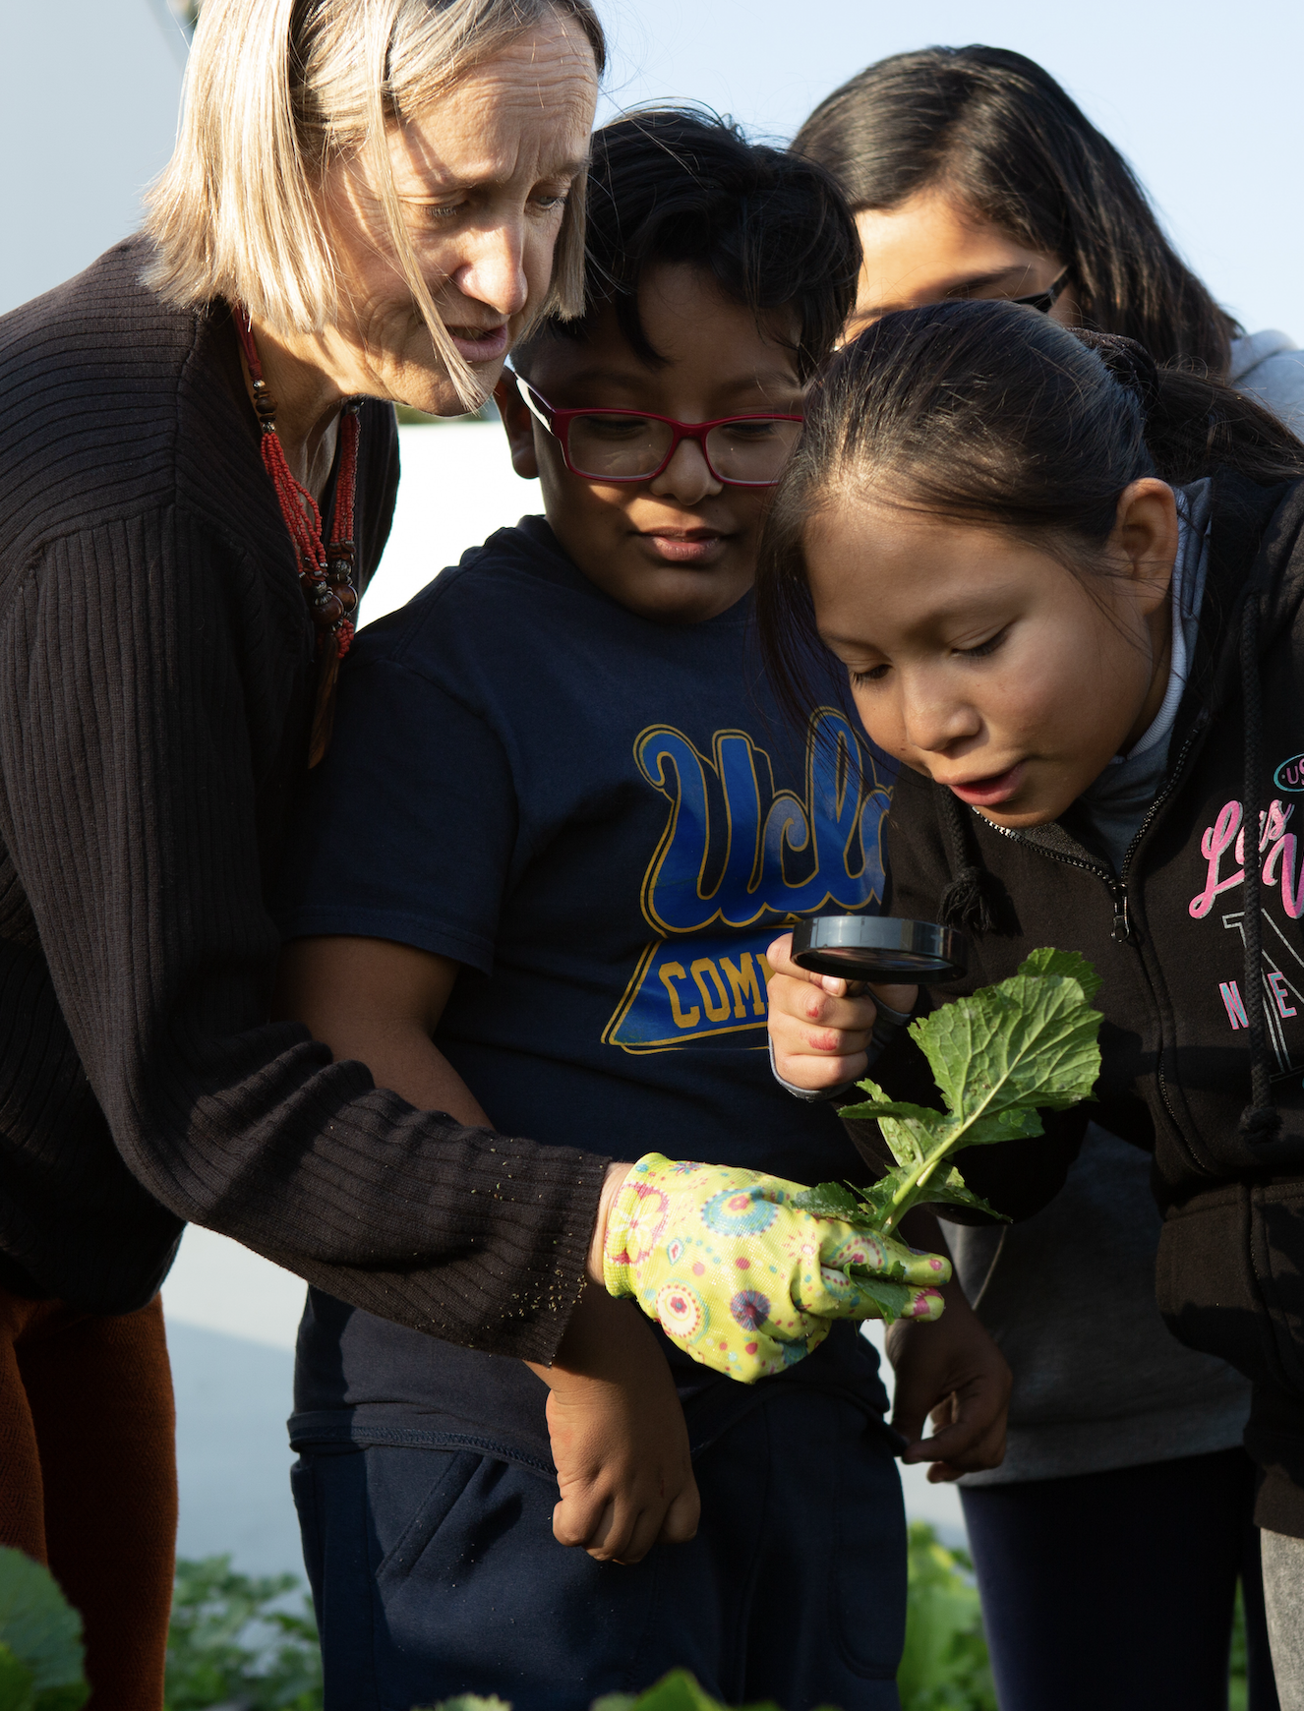
Observing
Observing is carefully looking at something or someone to gather information.​
Photo by Allison Shelly for EDUimages, CC BY-NC 4.0​

Slide 13
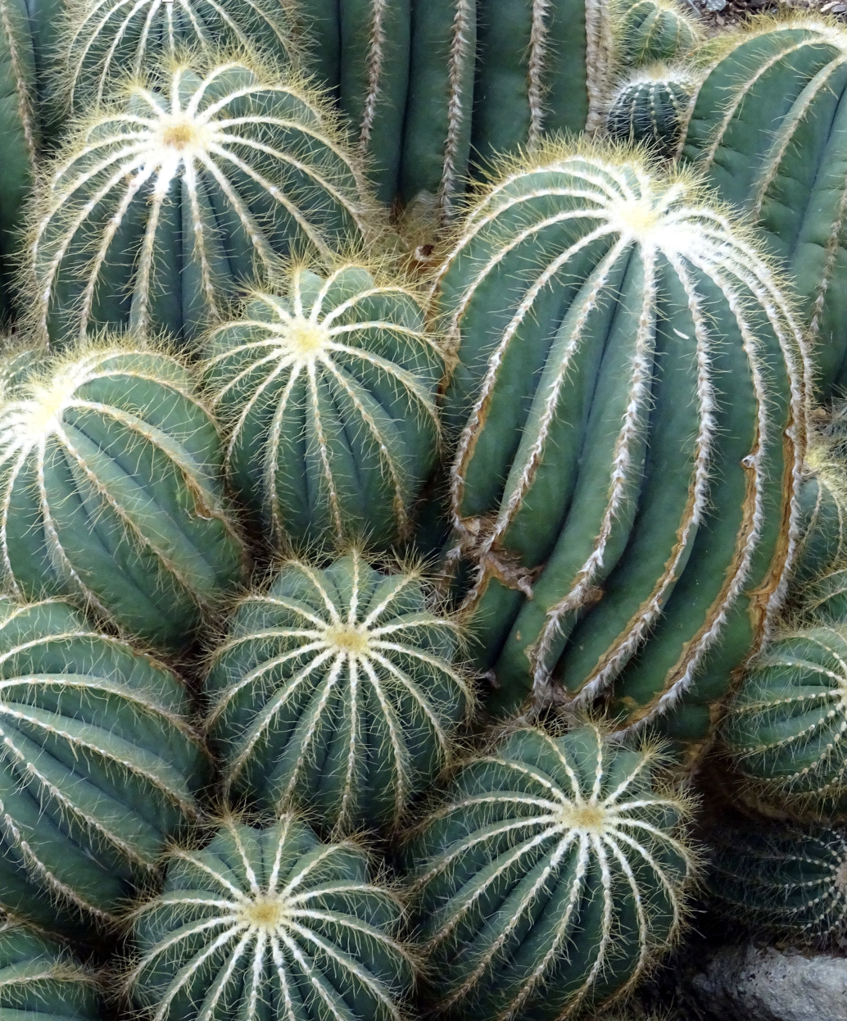
Offspring
Plants and animals, including humans, produce offspring.
"Green Cactus Plants · Free Stock Photo

Slide 14
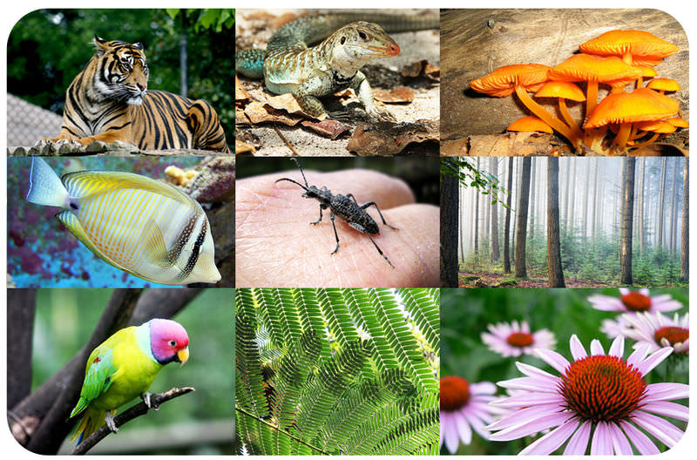
Organisms
Organisms are living things that carry out the activities needed to live, grow, and survive.​
This Photo by Unknown author is licensed under CC BY-NC.

Slide 15
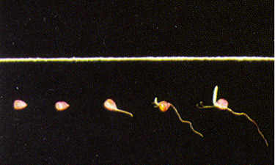
Radicle and Hypocotyle
The radicle is the first part of the seedling to emerge from the seed. It will become the root system as the plant grows.
The hypocotyle is the part of the embryo hat becomes the stem and the leaves.
This Photo by Unknown author is licensed under CC BY-SA-NC.

Slide 16
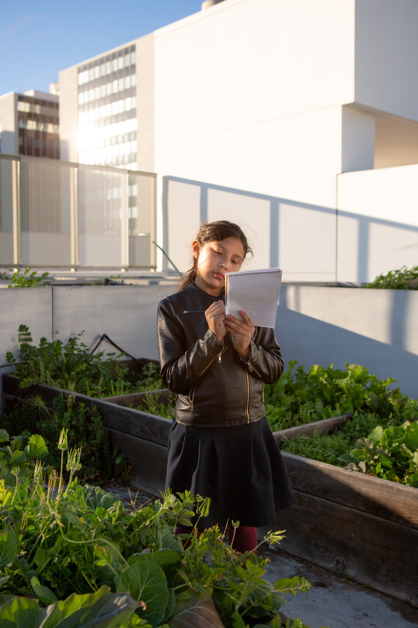
Reasoning
Reasoning means thinking about and explaining how the evidence supports a claim.
Photo by Allison Shelly for EDUimages, CC BY-NC 4.0​

Slide 17
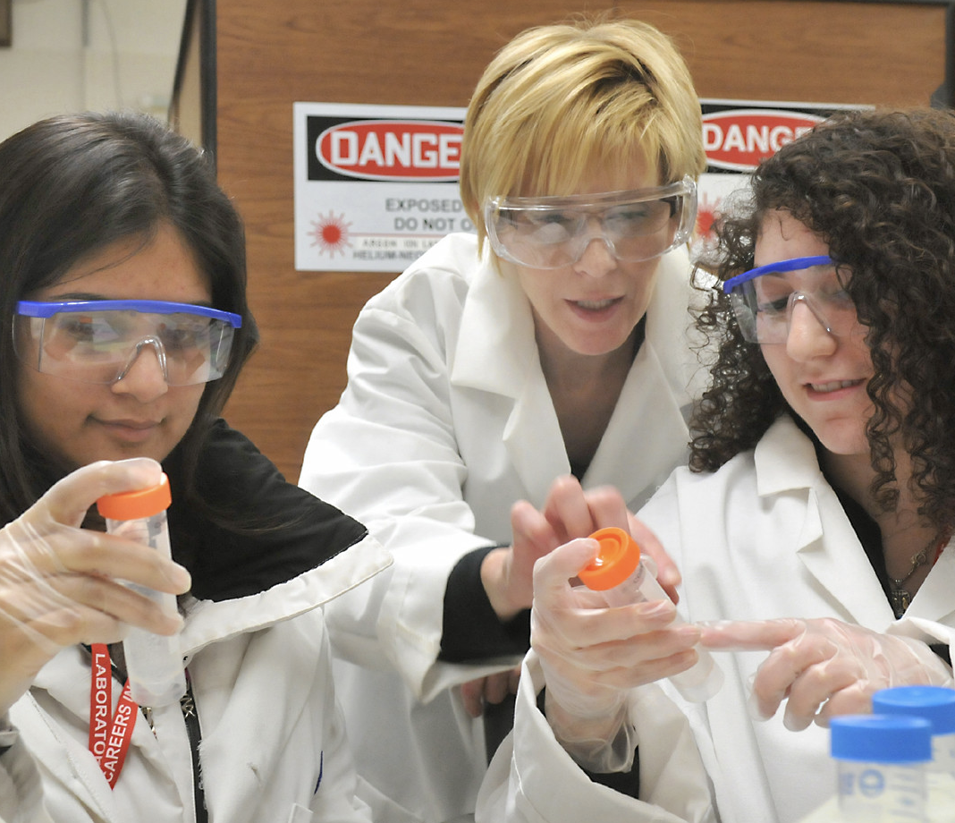
Science Investigation
A science investigation is a plan for finding answers to questions and solving problems.
"Science Careers in Search of Women 2009" by Argonne National Laboratory is licensed under CC BY-NC-SA 2.0.​

Slide 18
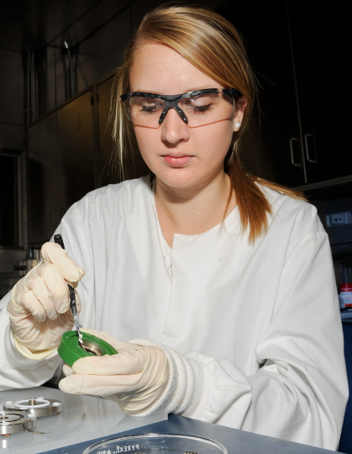
Scientist
A scientist is a person who is an expert in or
who studies aspects of the natural or physical world.​
Army scientists energize battery research" by U.S. Army Combat Capabilities Development Command is licensed under CC BY-SA 2.0. To view a copy of this license, visit https://creativecommons.org/licenses/by-sa/2.0/?ref=openverse.​

Slide 19
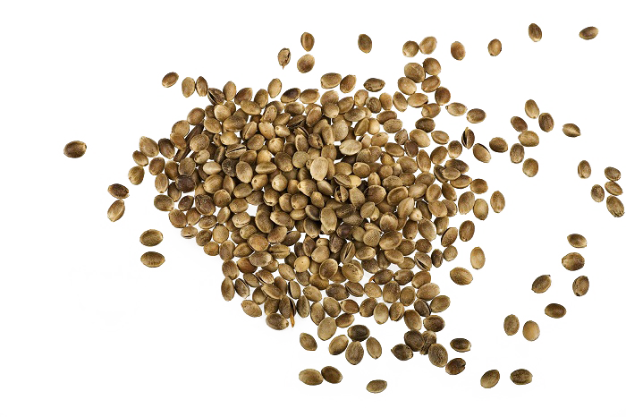
Seed
A seed is an undeveloped plant embryo and food reserve enclosed in a protective outer covering.
This Photo by Unknown author is licensed under CC BY-NC.

Slide 20
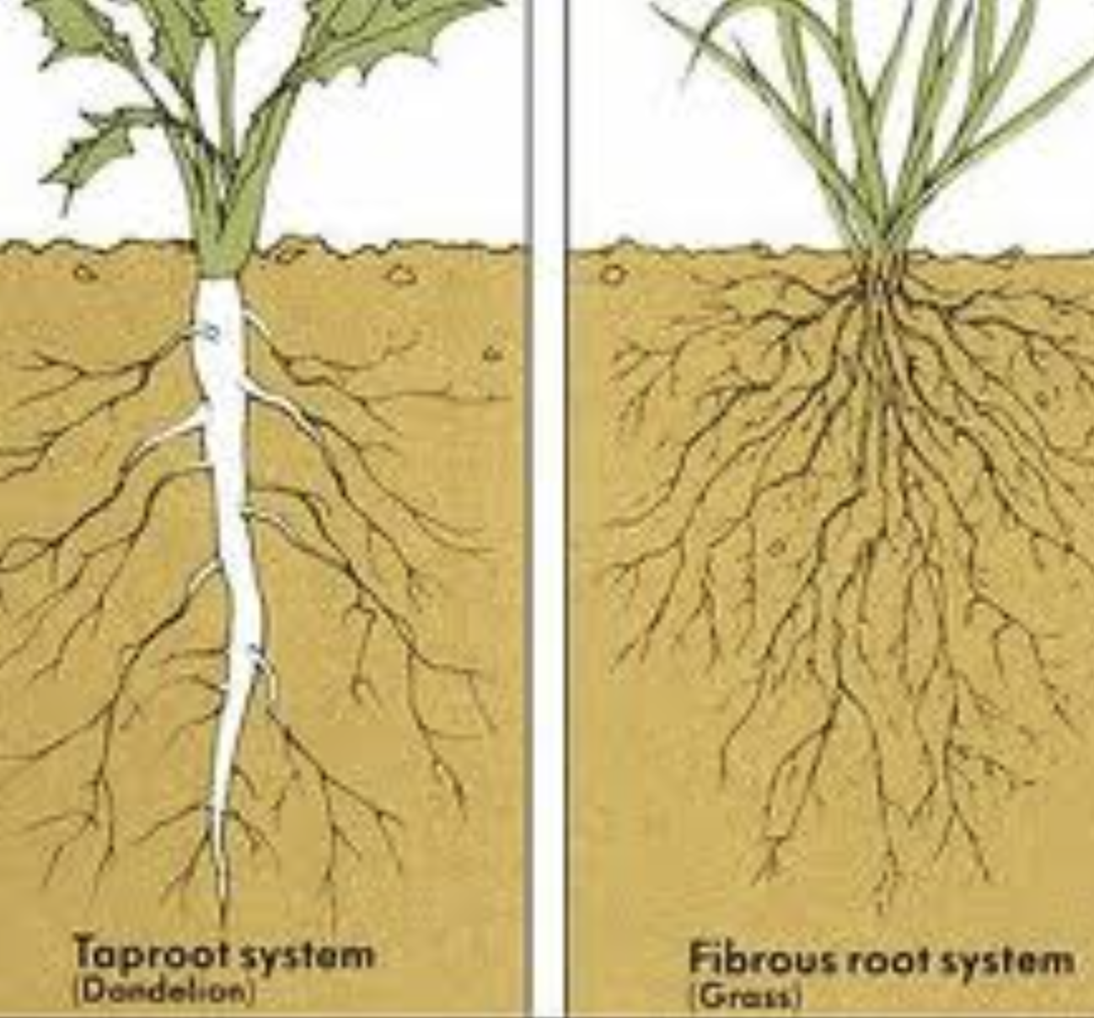
Taproots and Fibrous Roots
A taproot system has a large, straight root that grows directly downward and with smaller roots growing out of it.
A fibrous root system has thin, threadlike roots that are about the same length and grow in all directions.
https://commons.wikimedia.org/wiki/File:Tap_and_fibrous_root.jpg
Cassandra gonzales, CC BY-SA 4.0 <https://creativecommons.org/licenses/by-sa/4.0>, via Wikimedia Commons

Slide 21
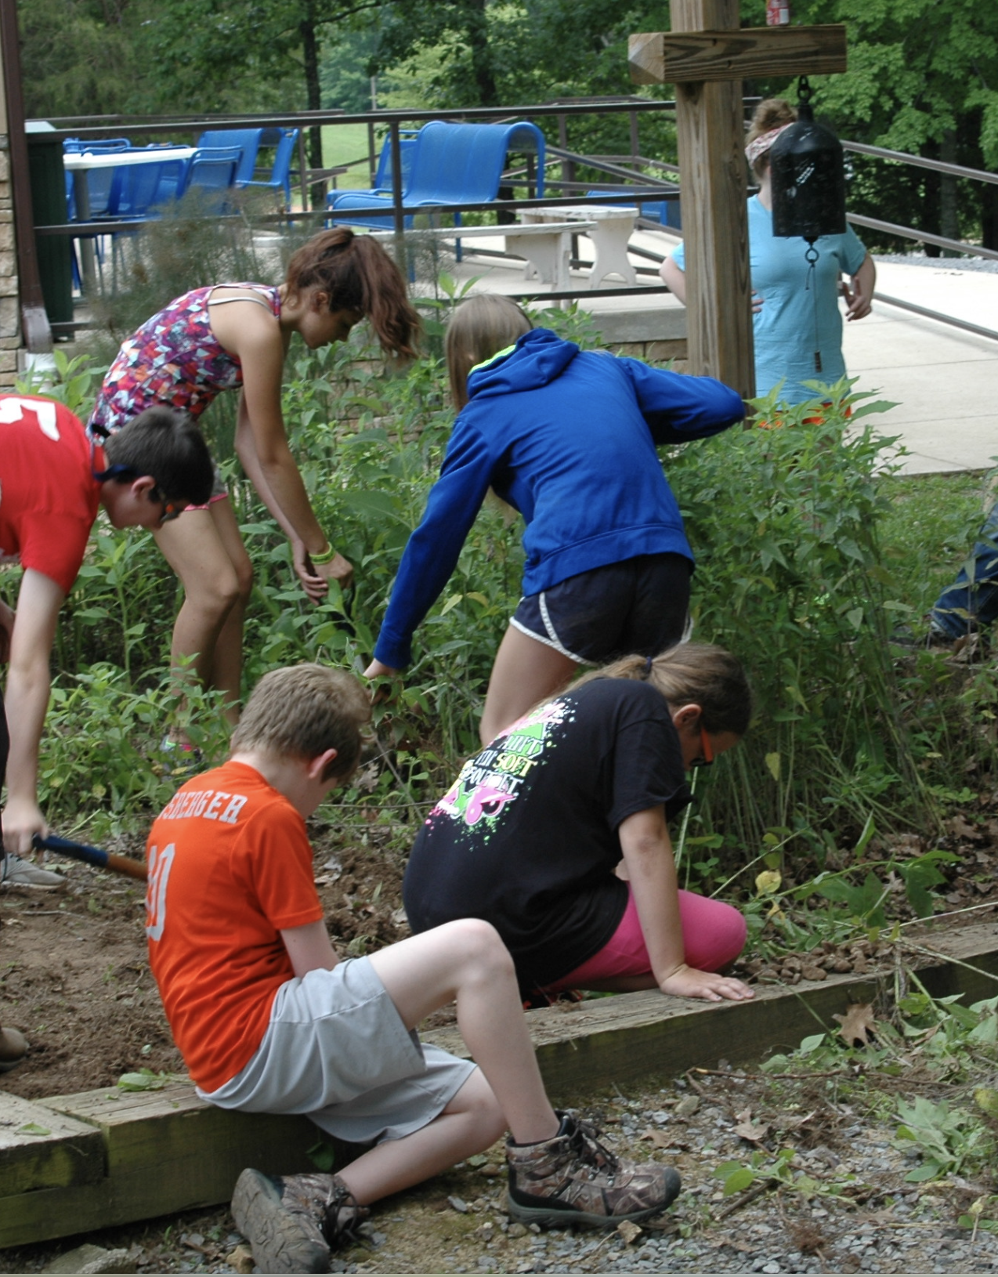
Team
A team is a group of people
who work together to accomplish a goal. ​
"Working and Weeding" by LandBetweentheLakesKYTN is marked with Public Domain Mark 1.0. To view the terms, visit https://creativecommons.org/publicdomain/mark/1.0//?ref=openverse.

Slide 22
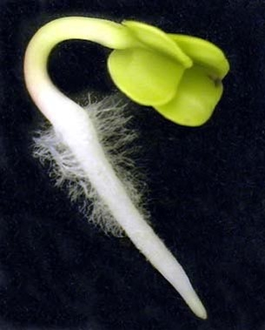
Testable Question
A testable question is connected to a specific science concept and can be answered through an investigation or experiment.
How does gravity affect the growth of plant roots?
This Photo by Unknown author is licensed under CC BY.

Slide 23
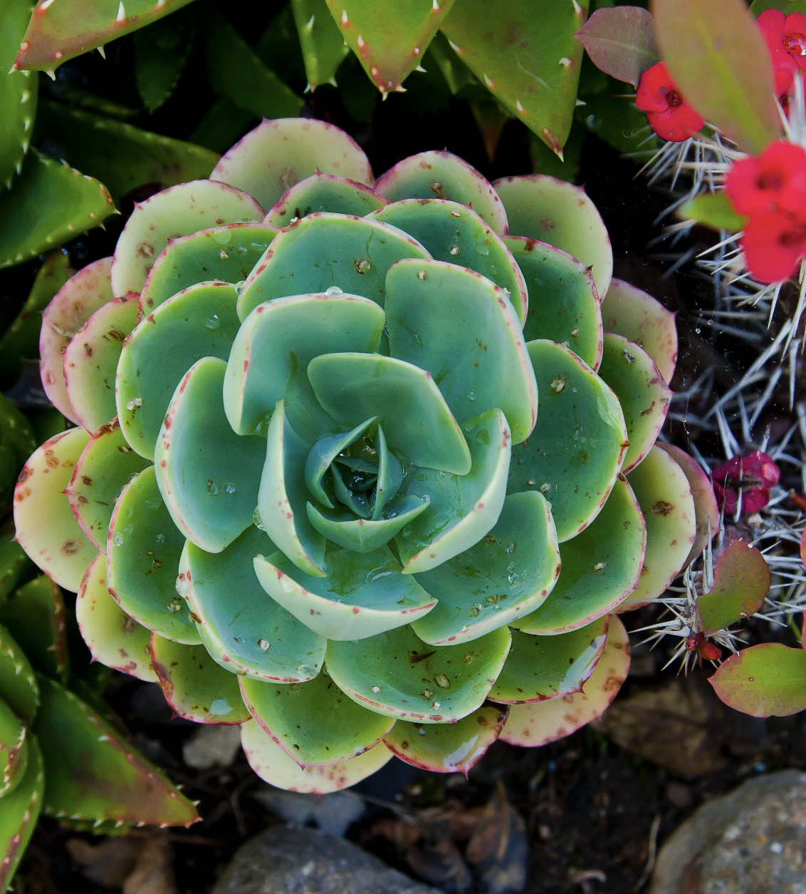
Trait
A trait is a physical attribute of an organism such as eye color, feathers, or the shape of leaves.
"Ghos-trait." by igKnition. is licensed under CC BY-SA 2.0. To view a copy of this license, visit https://creativecommons.org/licenses/by-sa/2.0/?ref=openverse.

Slide 24
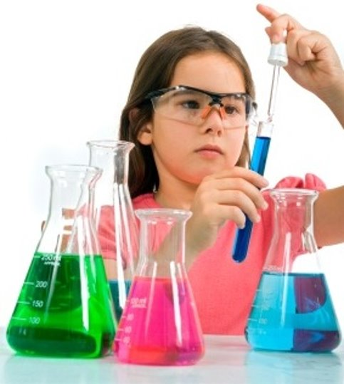
Variable
A scientific variable is something (a factor or condition) that can change or potentially change in a scientific investigation.
This Photo by Unknown author is licensed under CC BY-SA-NC.​

